Slide 1

Retro Roller
Tabletop Stat-Tracker
Michael Lisenko
Olivia Cheng
Aaron Sparks
McKinley Harmon
Cayden Hernandez

Slide 2
Introduction:
Playing a Tabletop game is a lot to keep track of. Dice, character sheets, pencils, miscellaneous paper for tracking enemies and equipment. It's much easier to just put all of that in one place and have everyone know where all their stuff is. This is the problem we solved.
Player tracker
Attributes/Inventory
Dice Roller
Initiative Tracker
Server automation

Slide 3
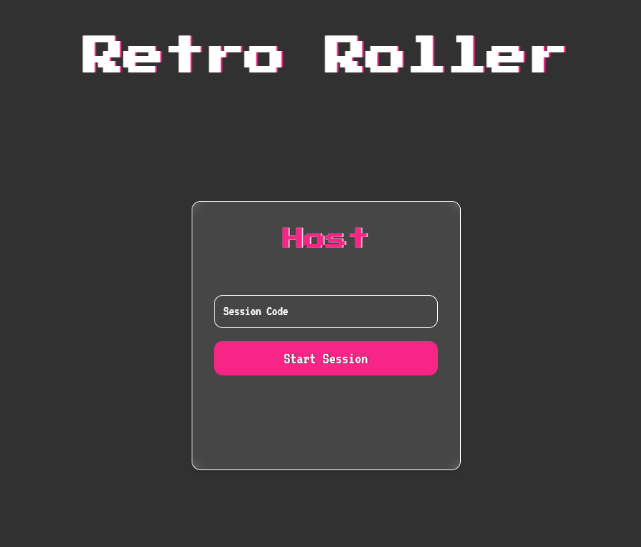
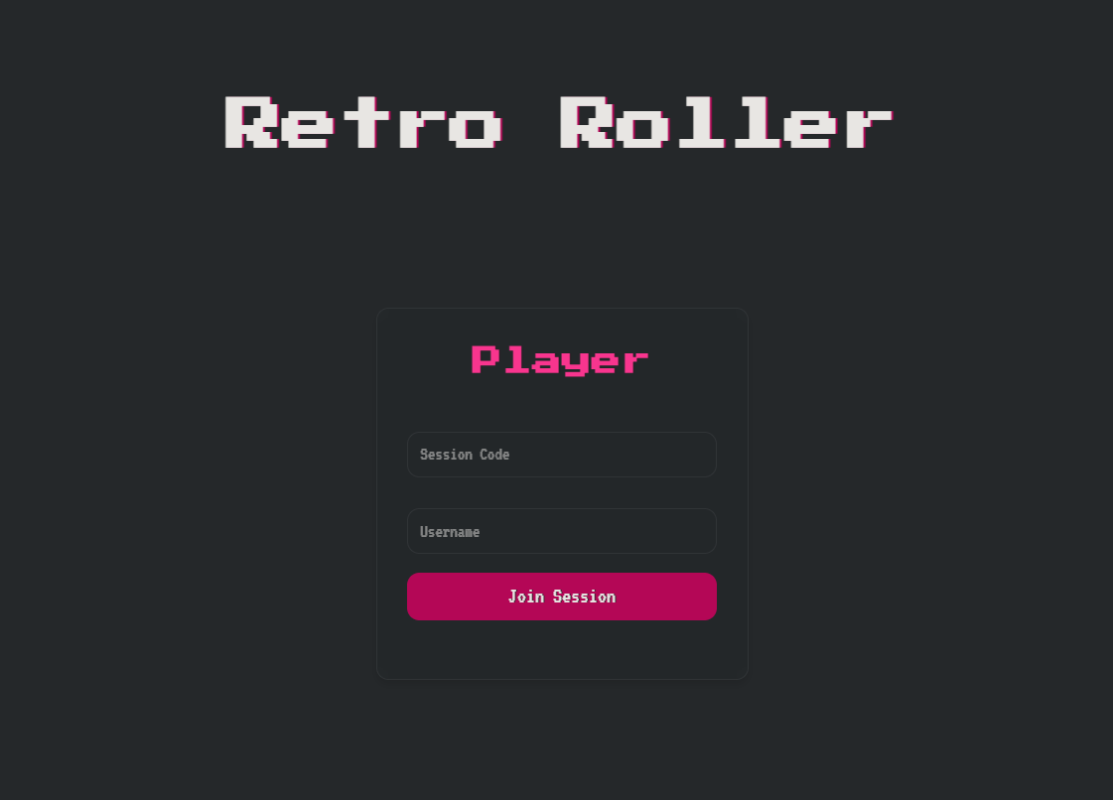
Player / Host Join:
Players are given a url and a token in order to log into the server. Once logged in, attributes and inventory can be updated and applied
URL: http://10.131.27.99:8000
Token: 12345

Slide 4
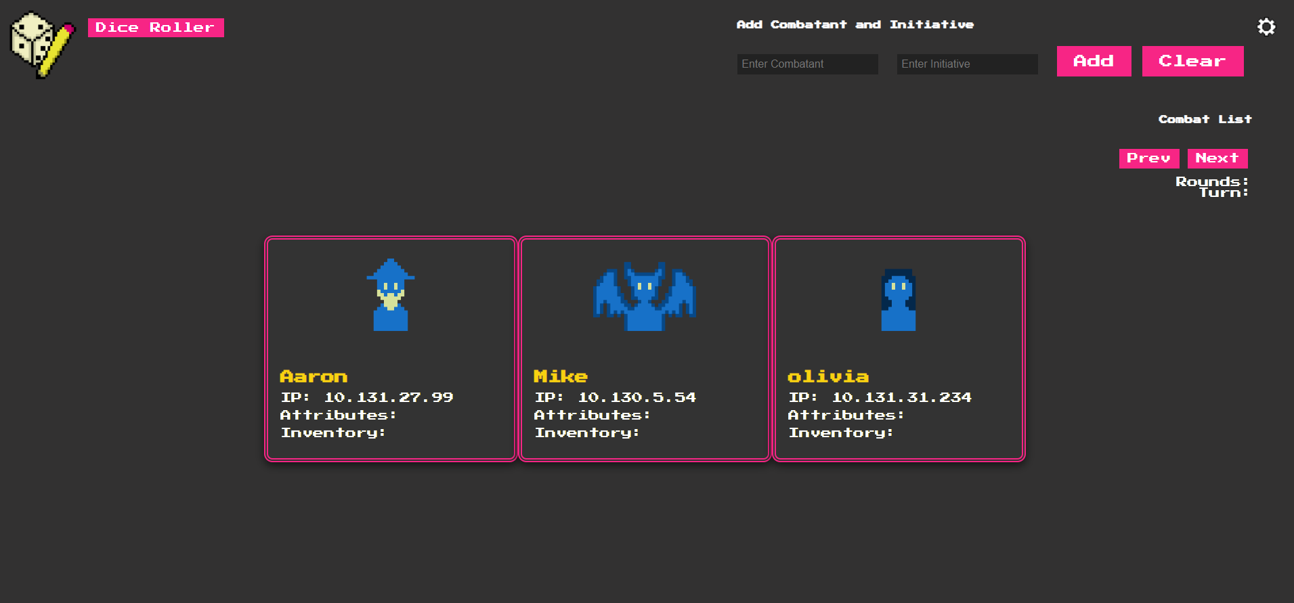
Host View:

Slide 5
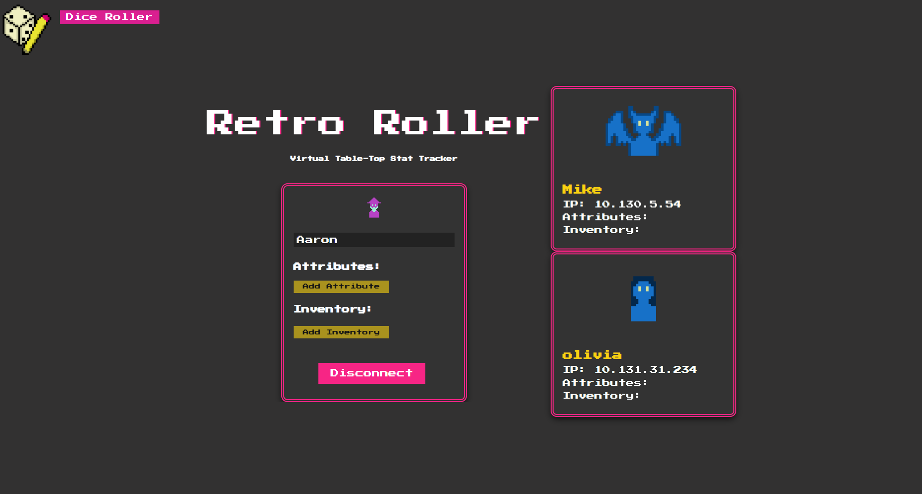
Player View:

Slide 6
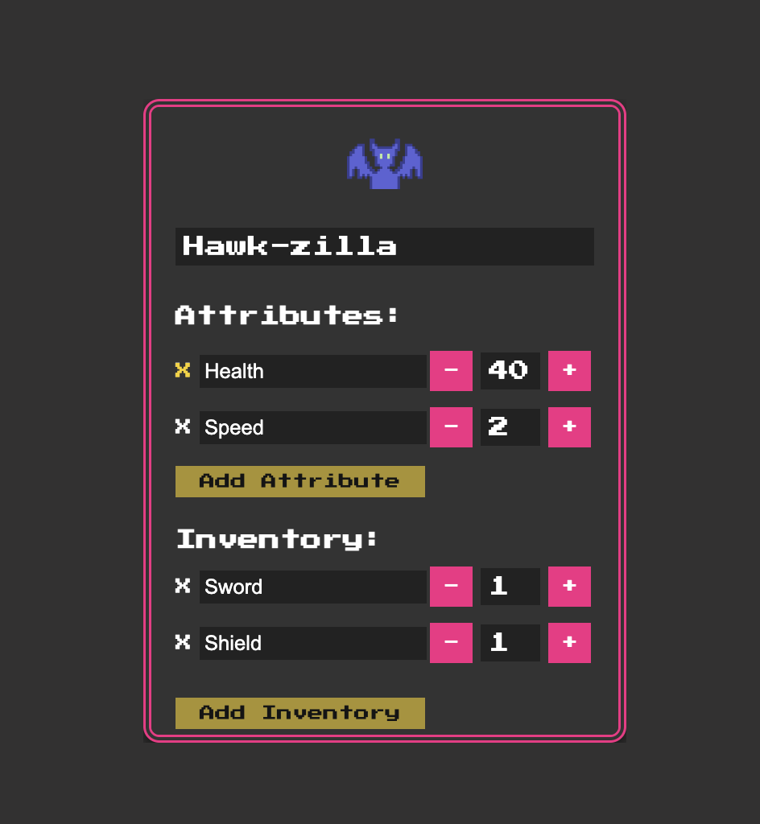
Attributes/Inventory:
Once players have joined, Players can add the necessary attributes needed for their specific character.

Slide 7
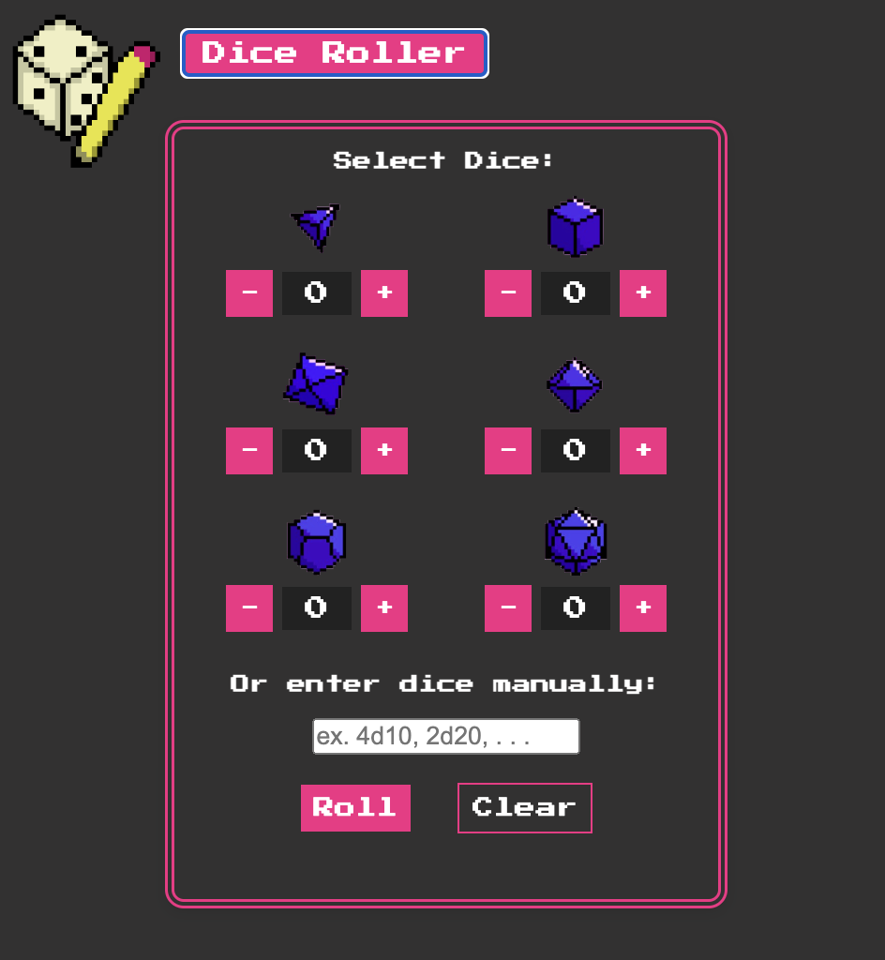
Dice Roller:
Option One:
Dice counters
Use the counters to roll multiple of different dice at once
Option Two:
Dice Field
Use the input field to put in a specific amount of a certain dice
Ex.
#Dice”d”Dice

Slide 8
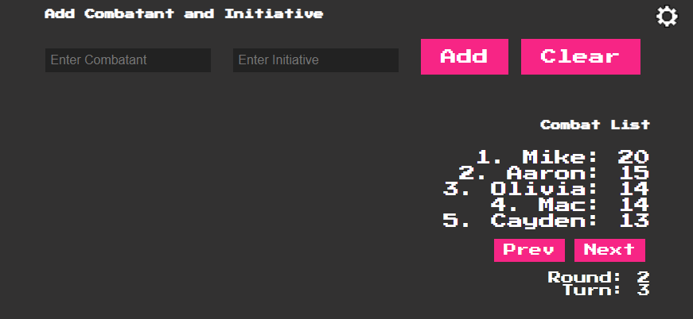
Initiative Tracker:
The initiative tracker allows the host to insert players and enemies alike to track turns and rounds. Names and Initiative numbers are inserted, and the tracker will organize the list of combatants. The host can then use the tracker to go through turns and rounds in order.

Slide 9
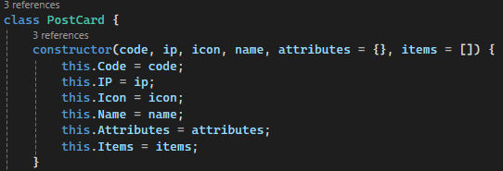
Server Info:
The server-side was built using Node.JS alongside Websockets. It is hosted locally from any player’s machine on Port 8000. Information is sent back and forth using packages of data we referred to as ‘Postcards’.
These packages are turned into JSON format for transfer between the client and server.

Slide 10
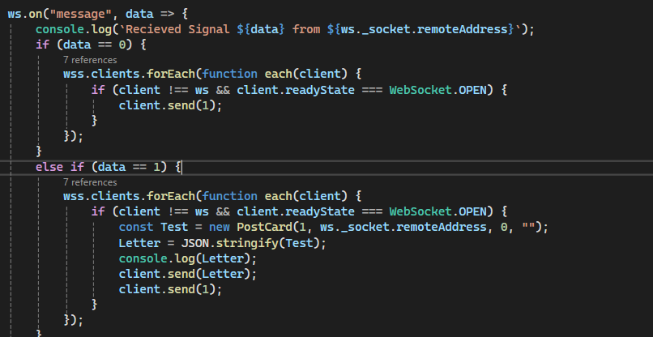
Server Info 2:
In addition to the ‘Postcards’, numbers can be sent between the server and client to signal different actions. For example, ‘0’ and ‘1’ are calls from the host and player respectively to grab information from other clients on first connection. These signals are sent to the server, which passes it to clients to send their data.

Slide 11
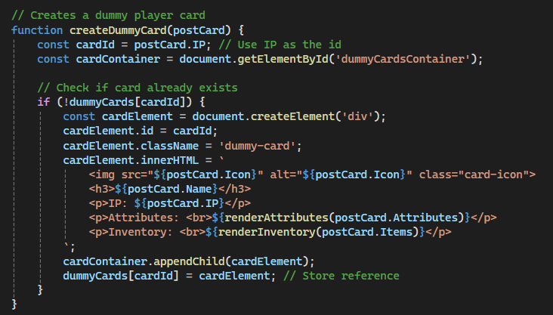
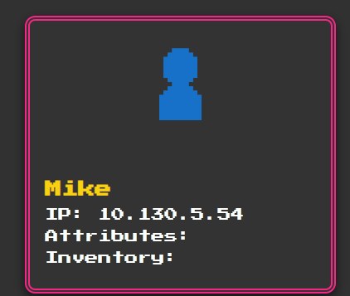
Server Info 3:
The cards users see are broken down into two categories: Player Cards, which are the customizable cards seen on the Player View, and Dummy Cards, which are the cards that are updated and changed around by the server.

Slide 12






DEMO

